Slide 1
Data Synchronization
Integrating Zoho Desk with Marketing Automation

Slide 2
Objective -
Integrating Zoho Desk with marketing automation platforms ensures seamless data synchronization, enabling users to access customer support data within their existing marketing workflows.

Slide 3
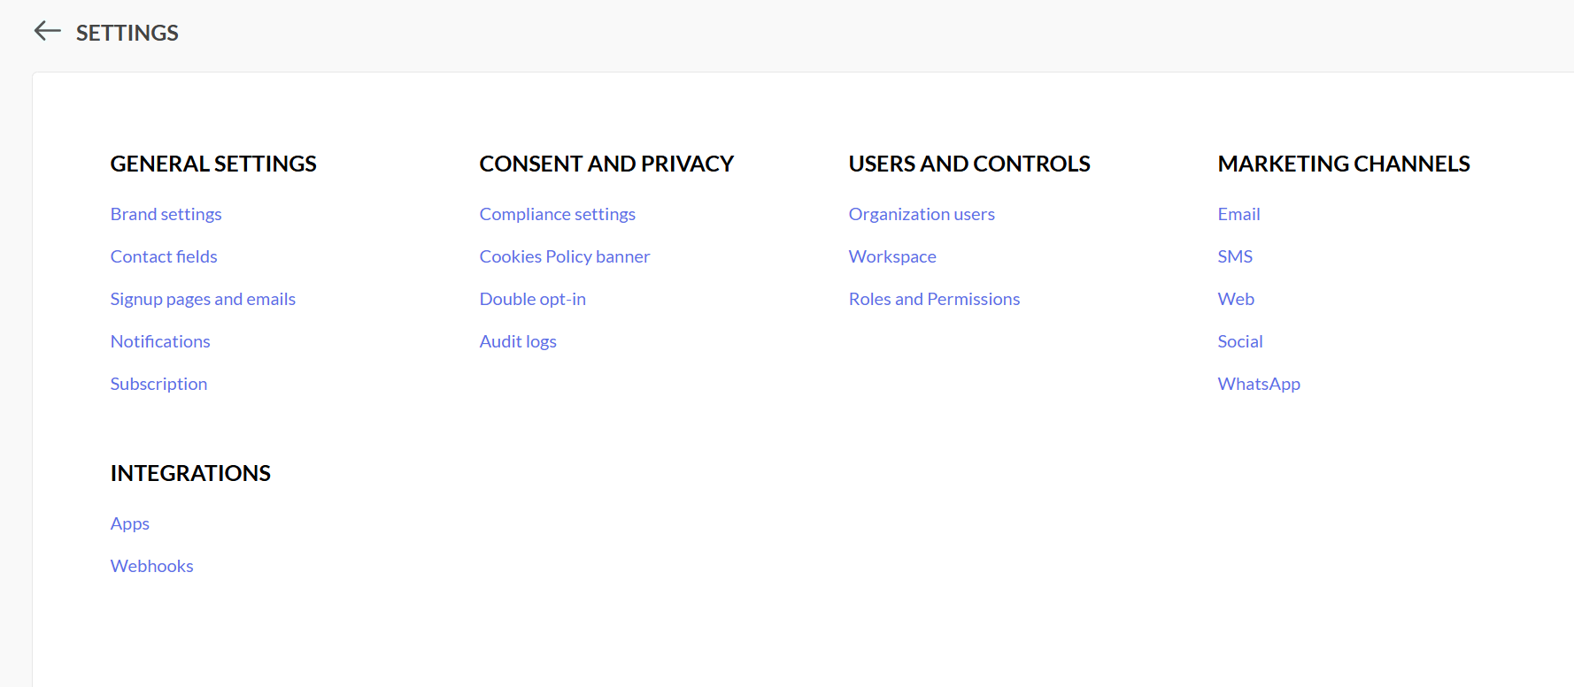
Implementation Step 1 -
Log in Zoho one Site with Administrator privilege.
Go to Marketing Automation > Integration > App > Zoho Desk > Connect > Syn Contact details from Zoho Desk to Zoho Marketing site

Slide 4
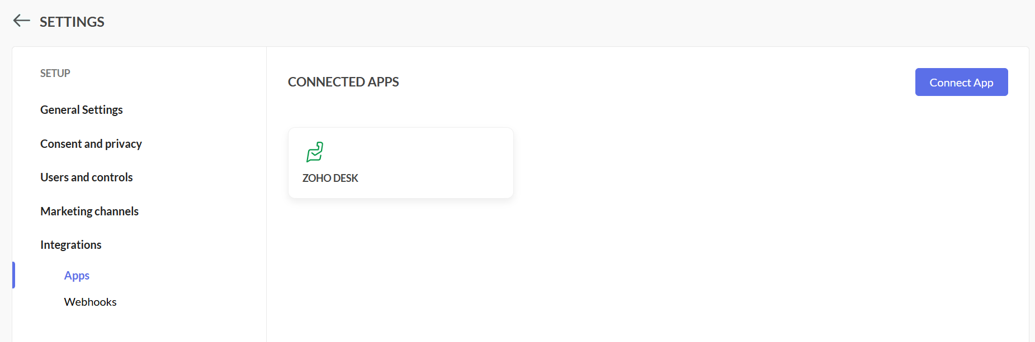

Slide 5
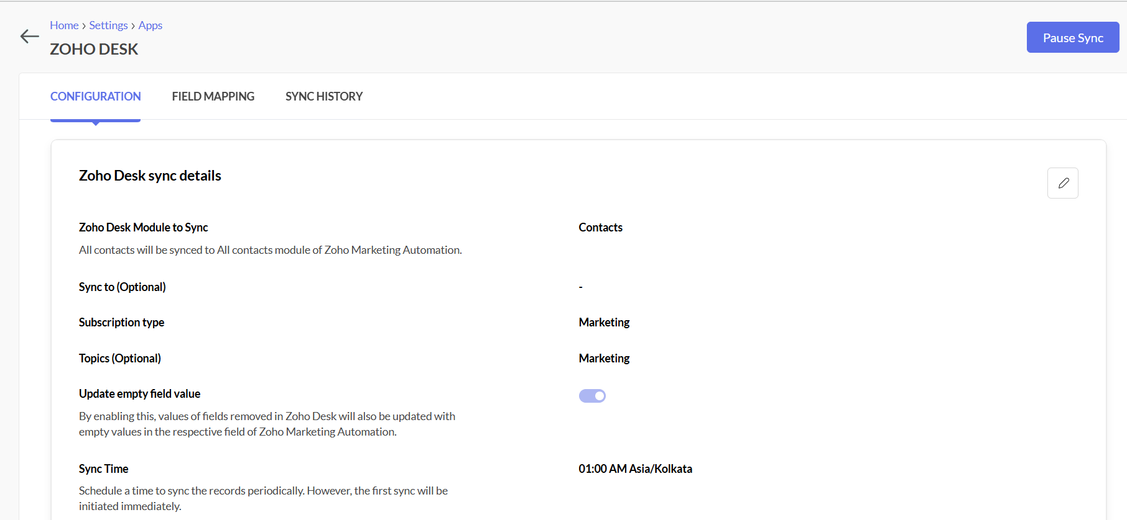
Scheduled a Sync time , hence sync will happen everyday without any fail .

Slide 6
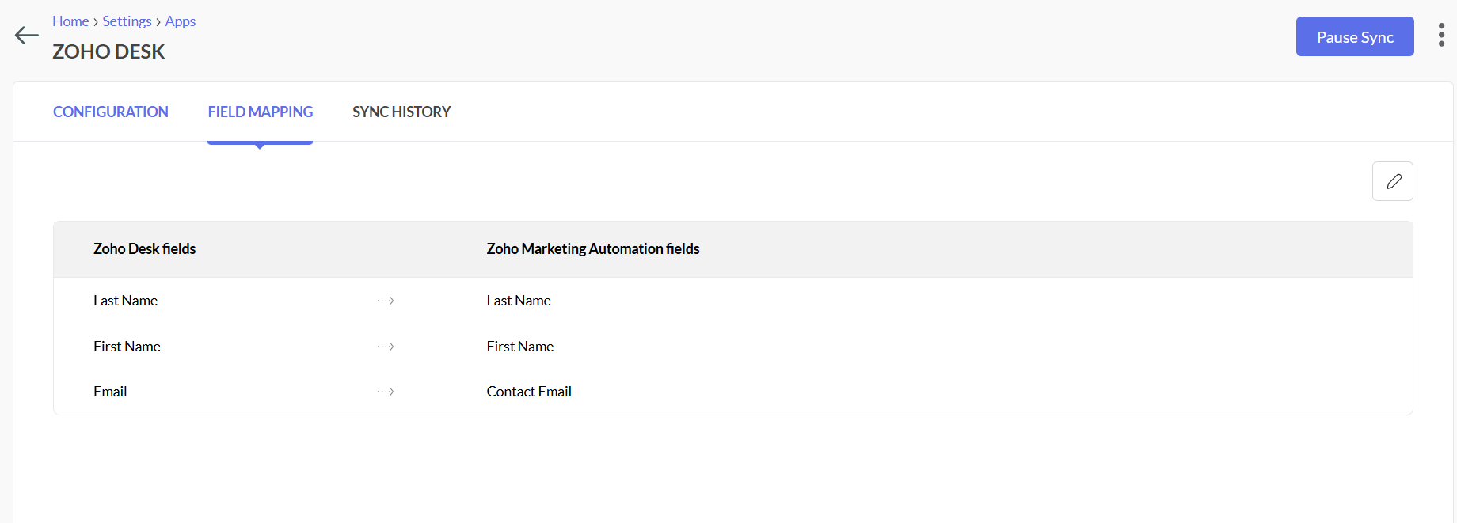

Slide 7
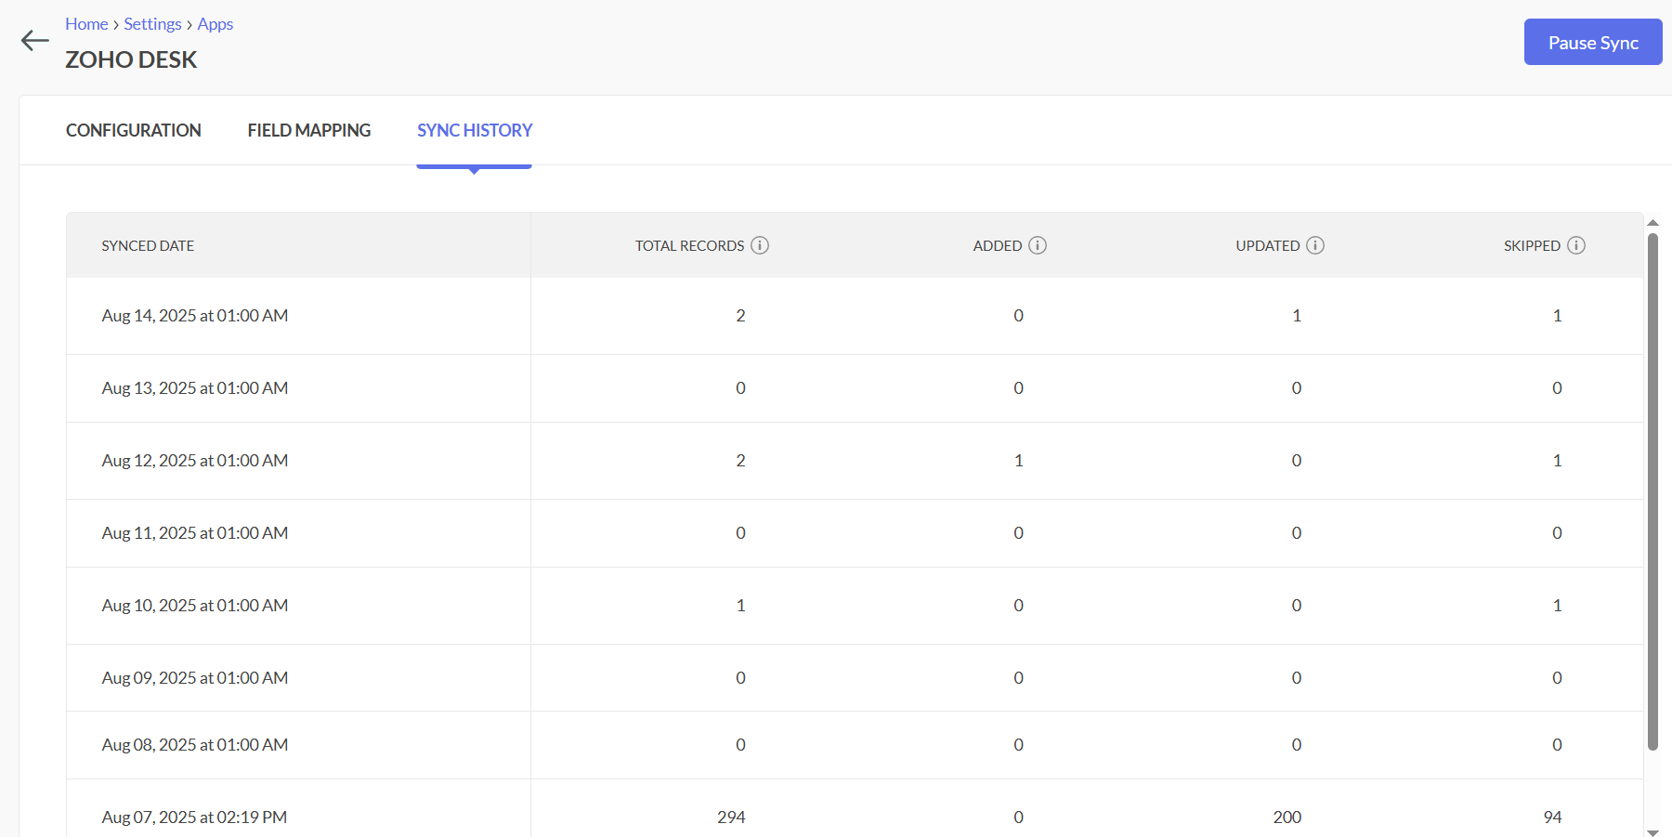

Slide 8
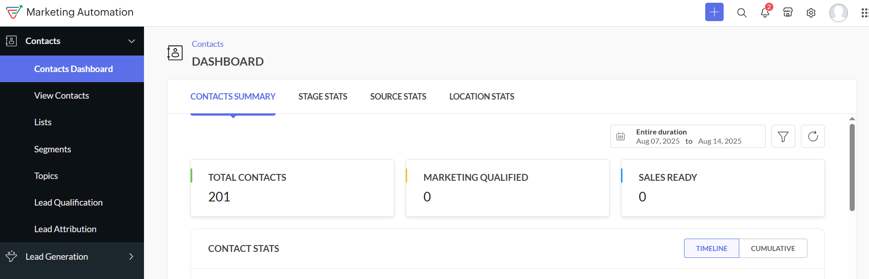
Implementation Stage 2: Go to Marketing Automation from side bar > Contact Dasboard

Slide 9
Output:
- From Dashboard we can see the number of contacts imported from Zoho Desk and classification of contacts based on there status .

